Slide 1

Monthly Sunspot
United Network of Professionals
-Capstone Project II
Pakki Venkata Teja

Slide 2
Contents
01
02
03
04
OBJECTIVE
EDA
ARIMA
VOTE OF THANKS

Slide 3
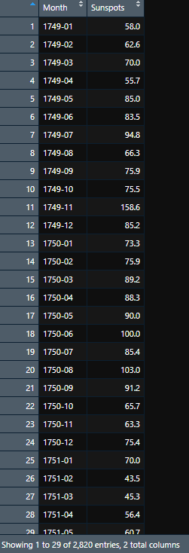
Objective
This dataset describes a monthly count of the number of observed sunspots for just over 230 years (1749-1983). The units are a count and there are 2,820 observations.
sunspot dataset, predict for next 10 years.
Split to train/test and report MAPE and AIC.

Slide 4
EDA

Slide 5
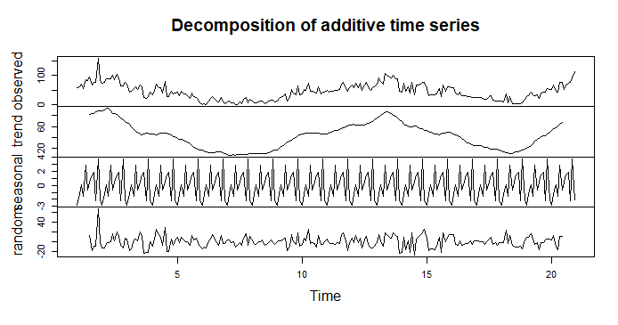
.

Slide 6
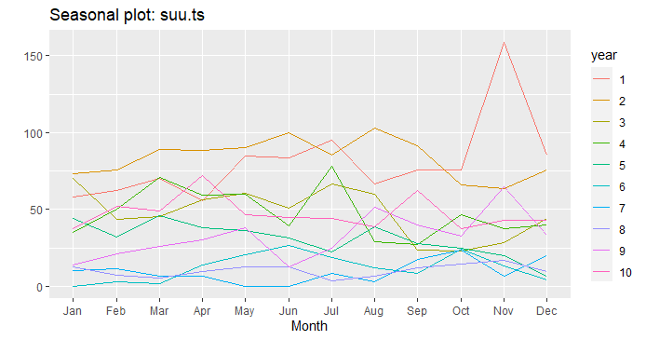
.

Slide 7
TRAIN DATA AND IT’S ADF TEST, KPSS TEST

Slide 8
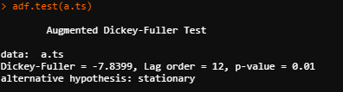

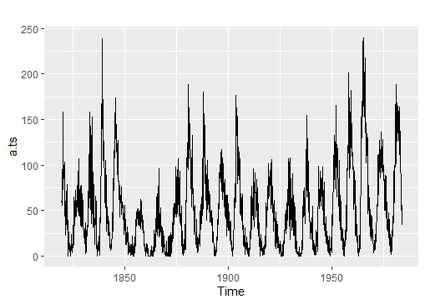
The attributes used for the prediction are year and sunspot data.
The train : test ratio is 70:30.
Train data is in stationary.
2019
2020
2021

Slide 9
Arima

Slide 10
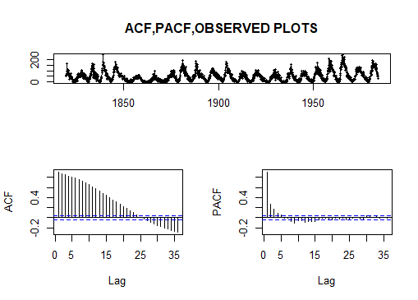
.
Arima is calculated depending on the order of (p, d, q).
From the PACF and ACF p, q values are 5,2 .
As there is no differencing value for train data(d=0).

Slide 11
Series: a.ts ARIMA(2,1,2)(2,0,0)[12]
Auto Arima
Coefficients:
ar1 ar2 ma1 ma2 sar1 sar2
1.2188 -0.3184 -1.6249 0.7047 0.0134 -0.0285
s.e. 0.0487 0.0411 0.0391 0.0334 0.0240 0.0230
sigma^2 estimated as 286.4: log likelihood=-8373.53
AIC=16761.06 AICc=16761.12 BIC=16800.17

Slide 12
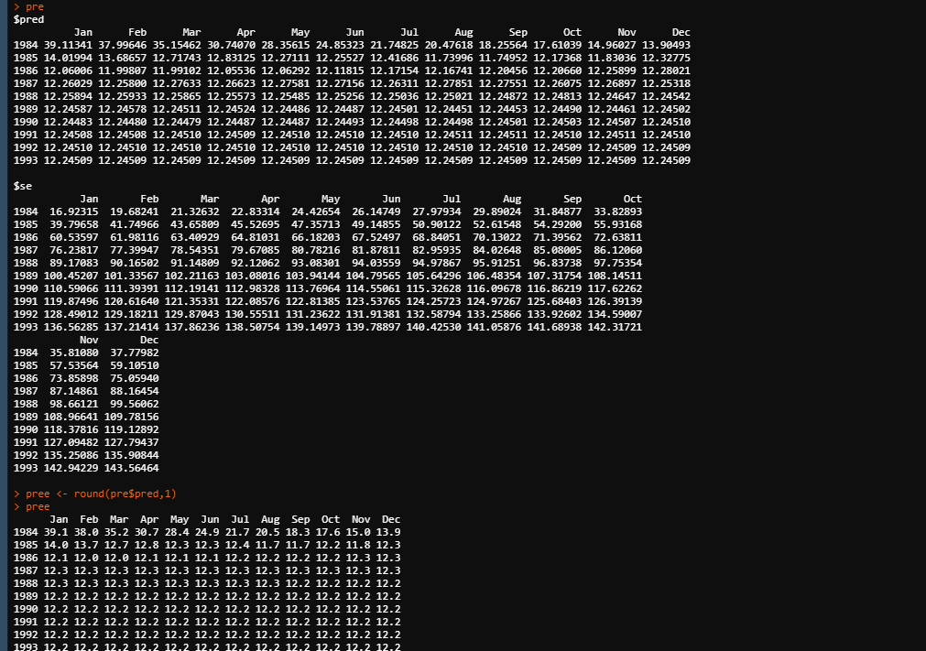
Predicted value are rounded to 1 decimal.
MAPE VALUE from predicted data and original data is 2.705901.

Slide 13

THANK YOU

